Slide 1
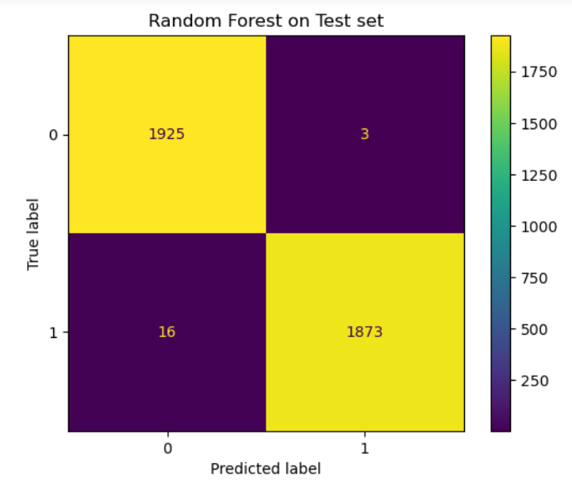
Executive Summary of Machine Learning Model Outcomes
Presented by TikTok data team
TikTok leadership ask data team to develop a machine learning model that can determine whether a video contains a claim or offers an opinion to reduce the backlog of user reports and prioritize them more efficiently. Previous investigation revealed that video engagement levels were highly indicative of claim status.
TikTok videos receive a large number of user reports. This is a potential problem since not all reported videos undergo review by human moderator. Since videos that make claims are more likely to have content that violates the term of service. TikTok seeks a better way to identify videos that make claims to prioritize them for review.
The data team built two tree-based classification models. Both models were used to predict on a held-out validation dataset, and champion model selection was determined by the best recall score. The champion model was then used to estimate future performance.
Both models (Random Forest (RF)and XGBoost) performed really well. The RF model had a better recall score (0.99085) and was selected as champion model.
Performance on test holdout dataset yielded excellent scores, only 19 misclassified samples out of 3,817.
Also feature importances indicated that the primary predictors were all related to video engagement levels, mainly with video view count, like count, share count, and download count.
With these results, we can conclude that videos with higher user engagement levels were much more likely to be claims.
Before deploying the model, the data team recommends further evaluation using additional subsets of user data. Furthermore, the data team recommends monitoring the distributions of video engagement levels to ensure that the model remains robust to fluctuations.

